Slide 1



ISDA & OTC Trade Life Cycle

Slide 2

DISCLAIMER
The training content and delivery of this presentation is confidential, and cannot be recorded, or copied and distributed to any third party, without the written consent of IMARTICUS Learning Pvt . Ltd.

Slide 3

YOU ARE GOING TO LEARN…
Introduction to ISDA
Introduction to OTC Markets
OTC Trade Life Cycle
Key players in OTC markets
Trade Lifecycle Overview
Real Life Examples

Slide 4

Introduction to ISDA and OTC Markets

Slide 5
ISDA - INTERNATIONAL SWAP DERIVATIVES ASSOCIATION
01
02
03
04
05
The ISDA was created due to the challenges the growing derivatives market posed for financial institutions.
The demand for derivatives grew with the increasingly global nature of finance, but a lack of clarity on what the parties in a derivatives transaction were risking and receiving hurt the industry.
ISDA wants to achieve three mains goals: reduce counterparty/ credit risk, increase market transparency and improve the industry’s operational infrastructure
In order to facilitate the safe and efficient trading of derivatives, ISDA has created a standardized contract, known as the ISDA Master Agreement, for those firms that wish to participate in private derivatives transactions.
This association helps to improve the market for privately negotiated over-the-counter (OTC) derivatives by identifying and reducing risks in that market.

Slide 6
OBJECTIVE OF ISDA
The International Swaps and Derivatives Association (ISDA) has several key objectives and functions, primarily related to the over-the-counter (OTC) derivatives market. Some of the main objectives of ISDA include:
Standardization: ISDA works to create standardized documentation for OTC derivatives transactions, including the widely used ISDA Master Agreement. Standardization simplifies the trading process, reduces legal and operational risks, and enhances market efficiency.
Risk Mitigation: ISDA helps its members and the derivatives industry in general to develop risk management practices. This includes measures to reduce credit risk, operational risk, and legal risk in OTC derivatives transactions.
Market Infrastructure: ISDA plays a role in the development and improvement of market infrastructure, including trade repositories and market standards. These initiatives aim to enhance transparency and regulatory reporting in the OTC derivatives market.

Slide 7
OBJECTIVE OF ISDA
Dispute Resolution: ISDA has established mechanisms for dispute resolution in the event of conflicts or disagreements arising from derivatives transactions. This helps to ensure that disputes can be resolved efficiently and fairly.
Collaboration: ISDA promotes collaboration and cooperation among its members and the broader financial industry, fostering a sense of community and shared responsibility for the integrity and stability of the derivatives markets.
01
03
Market Data: ISDA collects and publishes data related to OTC derivatives markets. This data is used for various purposes, including risk analysis and market research.
02

Slide 8
ISDA - INTERNATIONAL SWAP DERIVATIVES ASSOCIATION
Created in 1985, the ISDA has members from institutions around the world
Global Financial Institutions, Asset Management Firms, Hedge Funds, Corporations, Law Firms, Regulators and Government Agencies, Technology and Service Providers, Market Infrastructure Providers and Academic and Research Institution
ISDA is not a regulatory body
This contract governs all over-the-counter “OTC” derivatives transactions, cleared or non cleared, entered into between counterparties.

Slide 9
ISDA - INTERNATIONAL SWAP DERIVATIVES ASSOCIATION
ISDA has five parts:
IMA - ISDA Master Agreement
Schedule
CSA - Credit Support Annex
Confirmation
Definitions

Slide 10
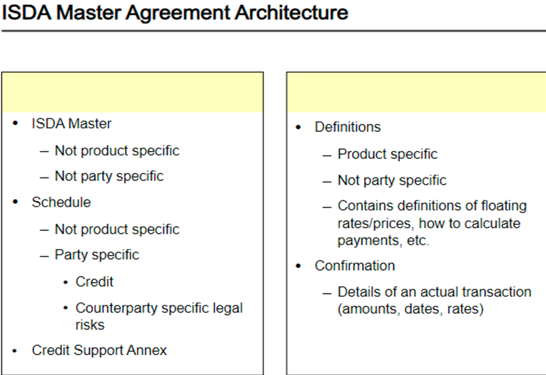
ISDA - INTERNATIONAL SWAP DERIVATIVES ASSOCIATION

Slide 11
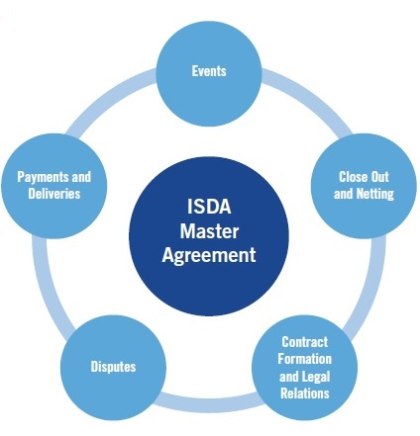
ISDA - IMA
01
NOT PRODUCT SPECIFIC
02
NOT PARTY SPECIFIC
IMA : this is the key document which defines the essential responsibilities of both parties, using predefined and standard terms and conditions (and which is typically not tailored to record particular arrangements between the two specific parties)
A pre-printed umbrella document which includes the boilerplate provisions (unless varied by the schedule to the master agreement)

Slide 12
ISDA - IMA
Events of Defaults and Termination Events
01
EVENTS
02
PAYMENT AND DELIVERIES
03
CLOSE OUT AND NETTING
04
DISPUTES
05
CONTRACT FORMATION AND LEGAL RELATIONS

Slide 13
EVENTS - EVENTS OF DEFAULTS AND TERMINATION EVENTS
Events of Defaults
1. Failure to Pay: Occurs when one party fails to make a required payment, such as interest, principal, or margin, when due.
2. Bankruptcy: If a party becomes insolvent, enters bankruptcy, or is subject to a similar event, it may trigger an Event of Default.
3. Cross Default: If a party defaults on a related financial agreement, it can trigger an Event of Default in the derivative contract.
4. Credit Support Default: If a party fails to post required collateral or provide a default amount, it may constitute an Event of Default.
5. Misrepresentation or Breach of Representations: A material misrepresentation or breach of representations and warranties by a party can trigger an Event of Default.
6. Illegality: If a change in law or regulations makes it illegal or impractical to maintain the derivative transaction, it may trigger an Event of Default.

Slide 14
EVENTS - EVENTS OF DEFAULTS AND TERMINATION EVENTS
Termination Events
Force Majeure: Certain extraordinary events beyond the control of the parties, such as acts of war, natural disasters, or government actions, can trigger a Termination Event.
Illegality: Similar to the Event of Default, a change in law or regulations that makes the transaction illegal can trigger a Termination Event.
Tax Event: If a change in tax law results in adverse tax consequences for one of the parties, it can trigger a Termination Event.
Termination for Convenience: Some derivative contracts allow for termination by one or both parties without cause, subject to certain notice and other requirements.
Credit Event: In credit derivatives, such as credit default swaps (CDS), the occurrence of a credit event related to the reference entity, such as a bankruptcy or failure to pay, can trigger a Termination Event.

Slide 15
ISDA - SCHEDULE
This is the second legal document (after the IMA) and is used to record the particular arrangements desired by both organisations, over and above the content of the ISDA master agreement
Typically use to alter the terms of and add terms to the pre-printed standard form ISDA Master Agreement
The ISDA Schedule is incorporated into, supplements and forms a part of the ISDA Master Agreement.
Schedule which allows parties to add to or amend the standard terms
The Schedule is what negotiators negotiate.
It typically takes at least 3 months to negotiate the Schedule but this can be shorter or longer depending on the complexity of the provisions concerned and the responsiveness of the parties.
PARTY
SPECIFIC

Slide 16
ISDA - CSA - CREDIT SUPPORT ANNEX
Credit Support Annex (CSA): this is the third legal document and is used to record the particular arrangements relating specifically to the posting of OTC derivative-related collateral between the two parties.
It is possible to have an ISDA agreement without a CSA but normally not a CSA without an ISDA
Types of Collateral Cash collateral (may be used for all Derivatives transactions)
Threshold Amount
Minimum Transfer
Independent Amount
Valuation Frequency and Source for Pricing
An optional document, the CSA is used when both parties agree to use collateral to cover risk exposures

Slide 17
ISDA - DEFINITIONS
PRODUCT SPECIFIC
All significant terms used in the Master Agreements are either defined in section 14 or as the parties agree in the Schedule. ISDA has prepared several specialist sets of definitions
Access below link to check the IMA and schedule
https://www.sec.gov/Archives/edgar/data/1107694/000119312508091225/dex1032.htm

Slide 18
Introduction to OTC Markets

Slide 19
WHAT IS OTC MARKET?
The OTC (Over-the-Counter) market, also known as the off-exchange market, is a decentralized financial market where the trading of financial instruments, such as stocks, bonds, commodities, derivatives, and foreign exchange, takes place directly between participants, typically over electronic networks or via telephone. In the OTC market, trading does not occur on a centralized exchange or organized trading floor, as it does in traditional exchange markets like the New York Stock Exchange (NYSE) or NASDAQ.

Slide 20
KEY CHARACTERISTICS OF THE OTC MARKET INCLUDE
Decentralization
OTC trading occurs bilaterally between buyers and sellers, often facilitated by dealers or brokers. There is no physical location or central exchange where trading takes place.
Accessibility
The OTC market is accessible to a wide range of participants, including financial institutions, corporations, individual investors, and government entities. It is less exclusive than many traditional exchanges.
Diversity of Instruments
OTC markets trade a wide variety of financial instruments, including stocks, bonds, currencies, commodities, and derivatives such as options and swaps.

Slide 21
KEY CHARACTERISTICS OF THE OTC MARKET INCLUDE
Customization
OTC transactions often involve customized or non-standardized contracts, allowing parties to tailor the terms of their agreements to meet their specific needs.
Lack of Transparency
OTC transactions are generally not as transparent as exchange-traded transactions. Pricing and trade details may not be publicly disclosed, which can impact market efficiency.
Counterparty Risk
OTC transactions involve counterparty risk, meaning that participants must consider the creditworthiness and financial stability of their trading partners.

Slide 22
KEY CHARACTERISTICS OF THE OTC MARKET INCLUDE
Regulation
OTC markets are subject to regulatory oversight, but the degree and type of regulation can vary by jurisdiction and asset class
Forex (Foreign Exchange) Market
The largest OTC market in the world, where currencies are traded in a decentralized manner.
OTC Derivatives Market
Many OTC derivative products, such as interest rate swaps, credit default swaps, forwards, SLB and options, are primarily traded in OTC markets.

Slide 23
Key Players in OTC Markets

Slide 24
THE MAIN PLAYERS IN THE OTC MARKET
Buy-Side Participants
Individual Investors: Retail investors who trade OTC securities, such as over-the-counter stocks or OTC derivatives.
Institutional Investors: Large organizations like mutual funds, pension funds, and insurance companies that trade OTC securities to manage their portfolios.

Slide 25
THE MAIN PLAYERS IN THE OTC MARKET
Sell-Side Participants
Broker-Dealers: Financial institutions that act as intermediaries between buyers and sellers, executing OTC trades on behalf of clients and providing market-making services. They may also take proprietary positions.
Market Makers: Firms or individuals that facilitate trading by continuously quoting bid and ask prices for specific securities, helping to maintain liquidity.
Investment Banks: These banks engage in various activities, including underwriting, trading, and advisory services in the OTC market.
Trading Desks: These are specialized units within financial institutions that handle trading activities in the OTC market, including trading, risk management, and order execution.
OTC Trading Platforms: Electronic platforms or networks that facilitate OTC trading, such as ECNs (Electronic Communication Networks) and alternative trading systems.

Slide 26
THE MAIN PLAYERS IN THE OTC MARKET
Intermediaries
Clearinghouses: Organizations that act as intermediaries in the settlement process, ensuring that transactions are completed and guaranteeing their financial integrity. Clearinghouses are particularly important in the OTC derivatives market.
Custodians: Institutions that hold and safeguard financial assets for clients. They may also provide services related to settlement and record-keeping.
Transfer Agents: Entities responsible for maintaining shareholder records and assisting with stock transfers and other corporate actions.

Slide 27
THE MAIN PLAYERS IN THE OTC MARKET
Hedge Funds and Asset Managers: These entities actively trade in the OTC market to implement investment strategies and manage portfolios.
Data Providers and Analytics Firms: Companies that offer market data, research, and analytics services, providing valuable insights to market participants.
Credit Rating Agencies: Entities that assess the creditworthiness of issuers and their securities, helping investors evaluate OTC investments.
Legal and Compliance Professionals: Lawyers and compliance experts who help market participants navigate the regulatory and legal complexities of the OTC market, including the negotiation and documentation of OTC agreements.

Slide 28
OTC-Trade Lifecycle Overview

Slide 29
TRADE LIFE CYCLE
Trading Activities
( Front Office)
Trade Initiation
Trade Execution
Trade Reporting
Trade Capture
Middle Office
Trade Enrichment
Trade Validation
Trade Verification
Operations
Trade Affirmation / Confirmation
Transaction Reporting
Trade Settlement
Trade Reconciliation

Slide 30
LIFE CYCLE OF AN OTC DERIVATIVES TRADE
1. TRADE INITIATION
In this step, traders will bring all the stakeholders together and discuss the possibilities of the trade. So, it is highly customized. A discussion about the client requirement and trade structure takes place. Stakeholders involved in it can be a
Legal and Compliance Team – to make sure that the trade transactions are legally correct and in compliance with the company’s policies;
Operations Team – to make sure that the deal is operationally done in the system and the system supports such customized OTC deal.
KYC Team – to onboard the client
RDM Team – to set up data
Risk Management Team – to identify the market risk, and credit risk involved in such deals;
Thus, all these stakeholders will make sure that the system and process are in place, Static Data is set up, IT is set up and Trade is executed properly.

Slide 31
LIFE CYCLE OF AN OTC DERIVATIVES TRADE
ISDA – IMA SCHEDULE CSA
Trade Execution - Order is placed by telephone or via an order management system (and in some cases, via the bank’s own order management system)
Reuters / EBS
Single Dealer Platforms/ Multi Dealer Platform
ECN's
Voice Brokers
SEF's
01
Once negotiation has been completed and both parties have applied their signatures, each of the documents will 1) state the names of the two organisations, and 2) be dated.
02

Slide 32
LIFE CYCLE OF AN OTC DERIVATIVES TRADE
2. TRADE EXECUTION
3. TRADE REPORTING
Trade execution occurs when two counterparties agree to a transaction. In OTC derivatives trading, this traditionally takes place over the telephone directly between two parties or through a broker. More recently, electronic trading systems have become available for counterparties to trade some of the more standardised OTC derivative products. Front Office agrees with the counterparty for the trade.
Trade reporting is mandatory for all financial instruments, including OTC derivatives.
Purpose: Ensure market transparency, so regulators can see price, volume, and timing, even for trades executed outside an exchange. Trade must be reported as soon as technically possible after execution, but no later than T+1 (the close of the next business day). Data Reported are :
Instrument identifiers (ISIN / CFI / other)
Price, notional amount, quantity
Buy/sell indicator
Counterparty identifiers (LEI)
Execution timestamp
Unique Transaction Identifier (UTI)
Venue of execution or OTC flag

Slide 33
LIFE CYCLE OF AN OTC DERIVATIVES TRADE
4. TRADE CAPTURE
Once a trade has been executed, the parties must capture the trade details in their internal systems for post-trade processing and risk management. Trade capture can be manual, where trade tickets prepared by traders are passed to the middle office for processing, or automated, where the trader enters the information directly into a front office trading system and the trade details flow through to downstream systems with limited or no manual intervention. Data on trades completed over third-party electronic trading systems can often be transferred into internal systems through a file transfer or direct link with the electronic trading platforms.

Slide 34
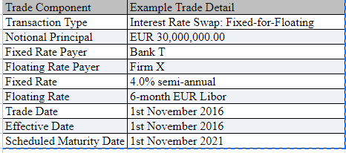
LIFE CYCLE OF AN OTC DERIVATIVES TRADE
TRADE CAPTURE
The information will be submitted to the Middle Office either electronically or manually using a trade ticket. Illustrates an example of a trade ticket.

Slide 35
LIFE CYCLE OF AN OTC DERIVATIVES TRADE
5. TRADE ENRICHMENT
Generically, cash payments are made by a firm by initially appointing a cash correspondent (or nostro) for a particular currency, then issuing a settlement instruction to that nostro for individual cash payments.
Deadlines are applied by nostros for the receipt of settlement instructions relative to the due date (or value date) of payment
In order to facilitate the payment of cash to a counterparty, it is common practice for standing settlement instructions (SSIs) to be stored within a firm’s static data repository.
6. TRADE VALIDATION
7. TRADE VERIFICATION
Trade details are validated through RDM
Confirming with FO

Slide 36
TRADE VALIDATION
Additional Rules
Trades Due to Settle on an FOP
Trades with a Cash Value At or Above a Certain Figure
Trades in a Specific Transaction
Trades with a Specific Counterparty.
Trades Due to Settle at a Specific Custodian.
Trades with Value Date in the past
All Amended Trades
All Cancelled Trades

Slide 37
LIFE CYCLE OF AN OTC DERIVATIVES TRADE
8. TRADE AFFIRMATION / CONFIRMATION
Counterparties can initially affirm the key economic details of their trades with each other before sending outgoing confirmations (ICE Link platform is an example of the affirmation model - trade affirmation services between sell-side firms and their buy-side clients).
A confirmation provides a more detailed view of a transaction at one point in time and should be sent as soon as possible.
A trade confirmation is also a legal document and is in addition to the set of documents signed prior to the first trade being executed.
In order to standardise the confirmation format, the ISDA has prepared a set of templates. Examples available on the ISDA's Bookstore
The primary purpose of issuing confirmations is to ensure that the counterparties agree on the economic terms of the trade
Dealers generally send out confirmations between one and five days after the trade date, usually by fax or telex.

Slide 38
LIFE CYCLE OF AN OTC DERIVATIVES TRADE
In order to standardise the confirmation format, the ISDA has prepared a set of templates. Examples available on the ISDA's Bookstore
MarkitSERV is an example of the confirmation matching model - two sell-side firms trade with one another
01
02

Slide 39
LIFE CYCLE OF AN OTC DERIVATIVES TRADE
Constituent of Confirmation
Economic Terms
Payment/Obligations
Timing And Method of Payment / Deliveries
Account Details
SwapsWire is an electronic dealing system designed for the electronic platform designed to promote efficiencies for the OTC derivatives market.
SwapsWire supports Interest Rate Swaps (IRS), Forward Rate Agreements (FRAs), Overnight Index Swaps (OIS), Interest Rate Caps and Floors, Interest Rate Swaptions, and Credit Default Swaps (CDS) in

Slide 40
LIFE CYCLE OF AN OTC DERIVATIVES TRADE
SHORT FORM - A short form document typically refers to a concise and simplified version of a legal agreement, often used in conjunction with or as an alternative to a more comprehensive and detailed master agreement. This short form document is designed to streamline the negotiation and execution process, making it quicker and more efficient for parties engaging in OTC transactions.
LONG FORM - However, with the same documentation in place, should the firm and the same counterparty choose to execute a trade in an OTC derivative product not covered by the legal documentation, the firm must take additional steps in order to protect itself. For example, if the firm executed a trade with the same counterparty in a variance swap, as this OTC derivative product is not covered by the existing legal documentation between the two parties, a long form confirmation should be issued by one of the parties and signed and returned by its counterparty.

Slide 41
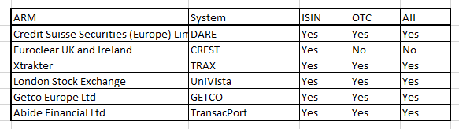
LIFE CYCLE OF AN OTC DERIVATIVES TRADE
9. TRANSACTION REPORTING - Transactions can be reported to the regulator by firms using systems known as approved reporting mechanisms (ARMs).

Slide 42
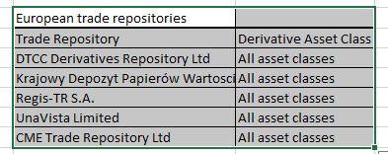
LIFE CYCLE OF AN OTC DERIVATIVES TRADE
CCIL has been designated as a Trade Repository by RBI to develop and provide a platform to market participants to report OTC derivatives deals executed in India.

Slide 43
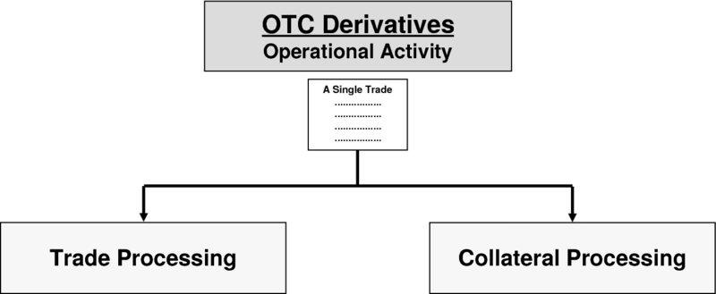
LIFE CYCLE OF AN OTC DERIVATIVES TRADE

Slide 44
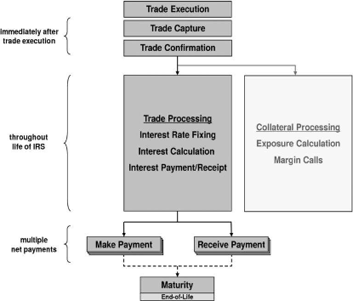
LIFE CYCLE OF AN OTC DERIVATIVES TRADE

Slide 45
LIFE CYCLE OF AN OTC DERIVATIVES TRADE
Trade processing
Collateral processing
Includes
The trade confirmation/affirmation process.
Settlement of OTC derivative trades, for example the payment of periodic interest in an interest rate swap, whilst
Involves
The identification of counterparty exposure,
The mitigation of such exposures via the issuance or receipt of margin calls, and
The movement of assets to or from the counterparty to settle the margin calls.

Slide 46
LIFE CYCLE OF AN OTC DERIVATIVES TRADE
From an operations perspective, both parties to an IRS trade must:
Calculate the net differential between the fixed interest rate and the floating interest rate for the period in question
Determine which party is responsible for making the net payment
And, the paying party must ensure payment is made to the counterparty on the due date, whilst the receiving party ensures the payment is received from its counterparty when falling due

Slide 47
LIFE CYCLE OF AN OTC DERIVATIVES TRADE
TRADE SETTLEMENT
There are two types of OTC derivative contracts:
Cleared OTC derivatives and
Non-cleared OTC derivatives
Traditionally, OTC derivative contracts are non-cleared and generally settled by the parties themselves. Payments and deliveries are made directly to one another. The two parties are taking credit risk on each other performing their obligations or remaining solvent.
Similarly, during a trade’s lifetime events can occur which cause: the trade to terminate earlier than its scheduled maturity date - trade/portfolio netting (trade compression), novation, unwind and offset.
However, if no such events arise, the exchange of cash flows will continue its life until the trade’s scheduled maturity date is reached.

Slide 48
OTC – CLEARING MODEL USED
Clearing model
OTC Cleared : traded on licensed trading venues known as swap execution facilities (SEFs) or multilateral trading facilities. They are traded via SEFs and setttled through via CCP platforms
OTC Non Cleared - Bilateral contracts (no clearing house)
Swap execution facilities (SEFs) are trading platforms intended for swaps products.
They are mandated under the Dodd-Frank Wall Street Reform Act of 2010.
Because of the complex nature of swaps, these platforms are not exchanges per se but they do function as a counterparty matching service.
Swaps traded on SEFs fall under the oversight of both the SEC and CFTC.
Notes:
Swap execution facilities (SEFs) are a type of marketplace for trading swaps in the United States. They are governed by the Dodd-Frank Act and rules of the United States Commodity Futures Trading Commission. Multilateral Trading Facilities (MTFs) are a type of marketplace for trading over-the-counter derivatives and other products in the European Union. They are governed by the Markets in Financial Instruments Directive (MiFID II) and other EU and local rule

Slide 49
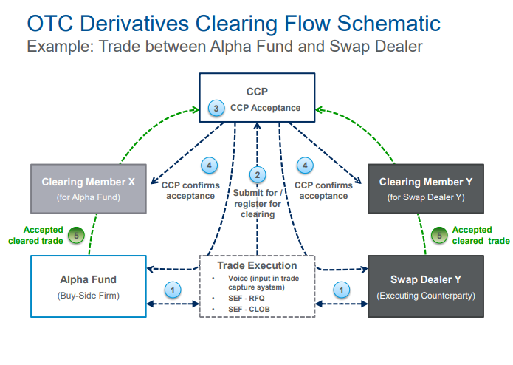
Typical OTC Cleared Derivatives Trade

Slide 50
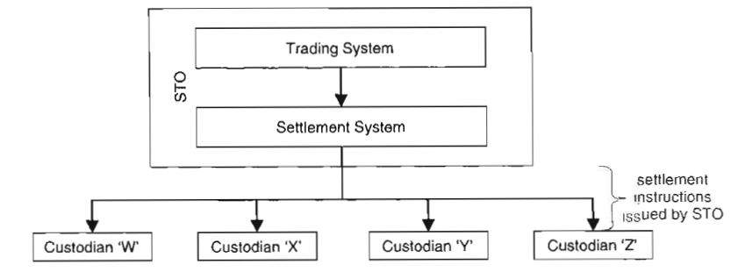
Settlement Instructions to the custodians

Slide 51
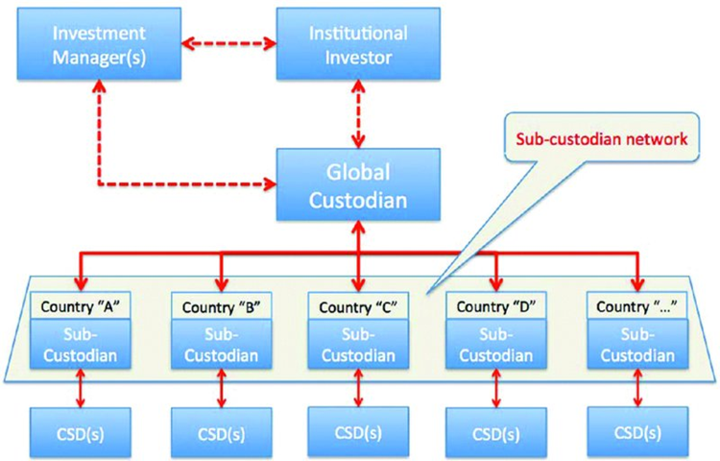
Settlement Instructions to the custodians

Slide 52
LIFE CYCLE OF AN OTC DERIVATIVES TRADE
Portfolio reconciliation - verification of the existence of all outstanding trades and comparison of their principal economic terms, is considered good market practice but does not occur routinely with OTC derivatives portfolios. Problems such as disagreements over collateral obligations or missed payments may prompt a portfolio reconciliation between counterparties. Still, most market participants argue that without an automated process for reconciling the details of some or all outstanding transactions, the process is too costly relative to the perceived benefits. TriOptima has been testing a portfolio reconciliation service (triResolve) and other service providers (eg Markit and Algorithmics) are reported to be developing similar services.

Slide 53
EXAMPLE OF OTC TLC WITH ISDA
A practical application of the International Swaps and Derivatives Association (ISDA) can be seen in the negotiation and execution of interest rate swaps, a common type of over-the-counter (OTC) derivative. Let's walk through a scenario where the ISDA Master Agreement is used in action:

Slide 54
EXAMPLE OF OTC TLC WITH ISDA
Scenario: Interest Rate Swap Transaction
Initial Contact
Negotiation Phase
Confirmation of Terms
Two financial institutions, Bank A and Bank B, decide to enter into an interest rate swap to manage their interest rate exposure. Bank A has a variable-rate loan, while Bank B has a fixed-rate loan.
The parties negotiate the key terms of the interest rate swap, such as the notional amount, fixed and floating interest rates, payment frequency, and maturity date. During this process, they may use the ISDA Master Agreement as a starting point.
Once the terms are agreed upon, the parties use a short form confirmation or term sheet that summarizes the key details of the transaction. This document references the ISDA Master Agreement for the full legal terms and conditions.

Slide 55
EXAMPLE OF OTC TLC WITH ISDA
Legal Review
Execution of Documents
Ongoing Transactions
Legal teams from both banks review the short form confirmation and ensure that it aligns with the terms and conditions outlined in the ISDA Master Agreement. The ISDA Master Agreement provides a standardized legal framework, reducing the need for extensive negotiations for each transaction.
The parties execute the short form confirmation, and by doing so, they incorporate the terms of the ISDA Master Agreement by reference. This legally binding confirmation document serves as evidence of the agreement to enter into the interest rate swap.
As part of the ongoing relationship between Bank A and Bank B, they continue to enter into additional interest rate swaps. For each new transaction, they may use a similar process, often leveraging the standardized terms and legal framework provided by the ISDA Master Agreement.

Slide 56
EXAMPLE OF OTC TLC WITH ISDA
Risk Management and Reporting
Dispute Resolution
The ISDA Master Agreement includes provisions related to events of default, termination events, and collateral management. These provisions help the parties manage and mitigate risks associated with the interest rate swap. Additionally, the agreement includes reporting obligations to ensure transparency between the parties.
In case of disputes or disagreements, the ISDA Master Agreement outlines a dispute resolution process, including provisions for mediation and arbitration.

Slide 57
Real World Examples

Slide 58
REAL WORLD EXAMPLES
Several OTC transactions have had widespread implications, influencing financial markets, institutions, and regulatory landscapes.
Long-Term Capital Management (LTCM) Crisis (1998)
LTCM was a hedge fund led by Nobel laureates and financial experts. The fund engaged in complex OTC derivatives transactions, particularly in the fixed-income markets. The fund's highly leveraged positions and interconnected trades led to massive losses. Concerns about LTCM's potential collapse prompted a consortium of banks to intervene and prevent a broader financial crisis. This event underscored the systemic risks associated with OTC derivatives and contributed to discussions on hedge fund regulation.

Slide 59
REAL WORLD EXAMPLES
Subprime Mortgage Crisis (2007-2008)
The subprime mortgage crisis involved OTC derivatives tied to mortgage-backed securities. Complex financial products, such as collateralized debt obligations (CDOs) and credit default swaps (CDS), were central to this crisis. When the U.S. housing market collapsed, the interconnectedness of financial institutions through OTC transactions amplified the impact globally. Lehman Brothers' bankruptcy in 2008 highlighted the vulnerability of financial institutions heavily involved in OTC markets, leading to widespread economic downturns and regulatory reforms.

Slide 60
REAL WORLD EXAMPLES
European Sovereign Debt Crisis (2010-2012)
The crisis was fueled by concerns about the solvency of several European countries. OTC derivatives, particularly credit default swaps, were used to hedge exposure to sovereign debt. The interconnectedness of European banks through OTC transactions exacerbated the contagion effect. The crisis led to financial instability, bailouts, and increased regulatory scrutiny of sovereign debt-related OTC derivatives.
Swiss Franc De-pegging (2015)
The Swiss National Bank's unexpected decision to de-peg the Swiss Franc from the Euro in January 2015 had widespread implications for institutions holding OTC derivatives tied to currency values. The sudden move caused significant losses for some market participants, highlighting the risks associated with currency-related OTC transactions.

Slide 61
REAL WORLD EXAMPLES
Several OTC transactions have had widespread implications, influencing financial markets, institutions, and regulatory landscapes.
Archegos Capital Management Collapse (2021):
Archegos Capital Management, a family office, faced margin calls related to its leveraged equity positions. The unwinding of Archegos' OTC derivatives transactions led to significant losses for major banks involved. This incident raised questions about risk management practices, transparency, and the potential systemic impact of large OTC derivative positions.
These examples underscore the importance of understanding and managing risks associated with OTC transactions, as well as the need for effective regulatory oversight. OTC markets provide flexibility and customization but also pose challenges related to transparency, counterparty risk, and systemic implications. As a result, regulatory reforms, such as those introduced after the 2008 financial crisis, aim to enhance transparency, reduce counterparty risk, and improve overall market stability.

Slide 62



THANK YOU !!!
Contact us today! https://imarticus.org/

